Slide 1


Lecture No. 14
PHILOSOPHY OF RELIGION

Slide 2
1. Philosophical definition of religion.

Slide 3
There are several approaches to understanding the phenomenon of religion.
1. Epistemological – considering religion as one of the forms of social consciousness, based on faith, which cannot be subjected to a rational analysis for truth.
2. Ontological – attitude to religion as a system of worldview, which is based on confidence in the existence of God or other supernatural forces that created the world, man and govern them.
3. Sacred - Understanding of religion as a special form of human experience associated with faith in the sacred. Different peoples have their own understanding of the sacred.

Slide 4
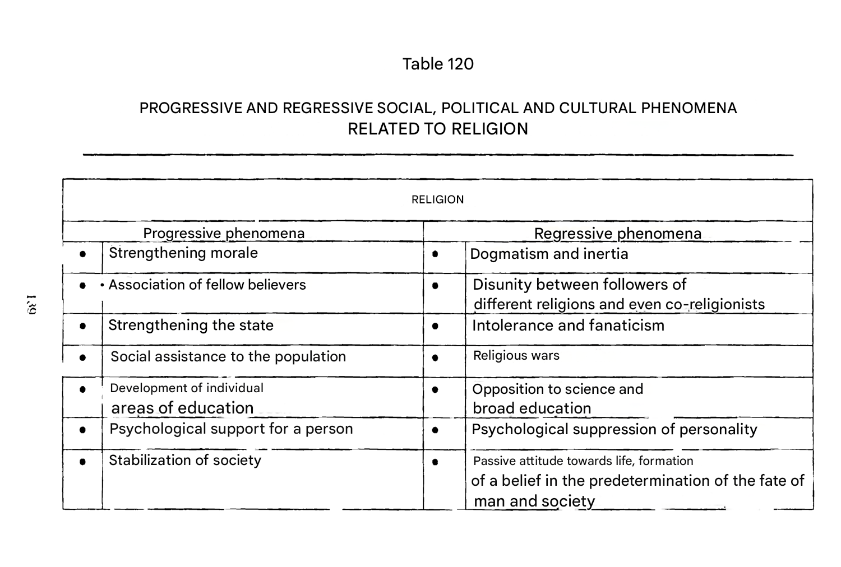

Slide 5
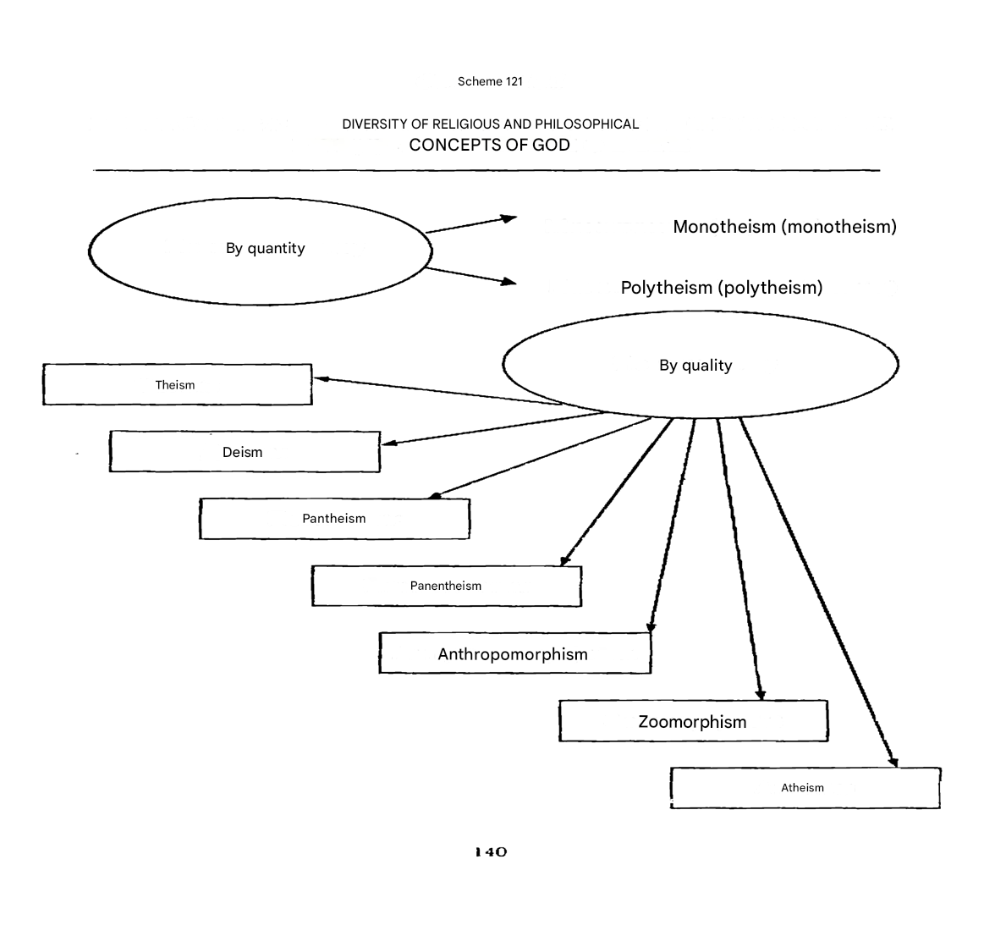

Slide 6
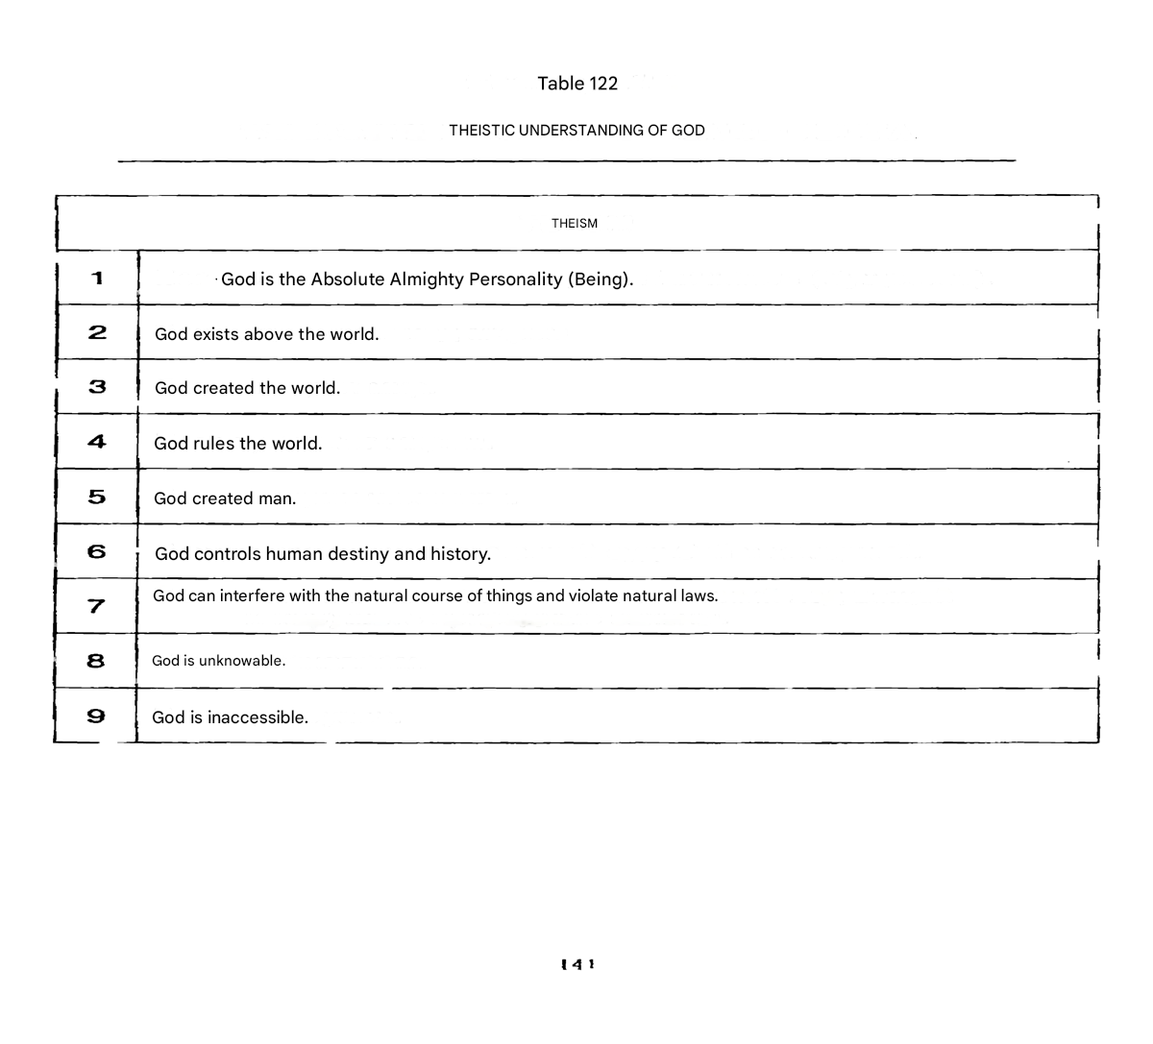

Slide 7
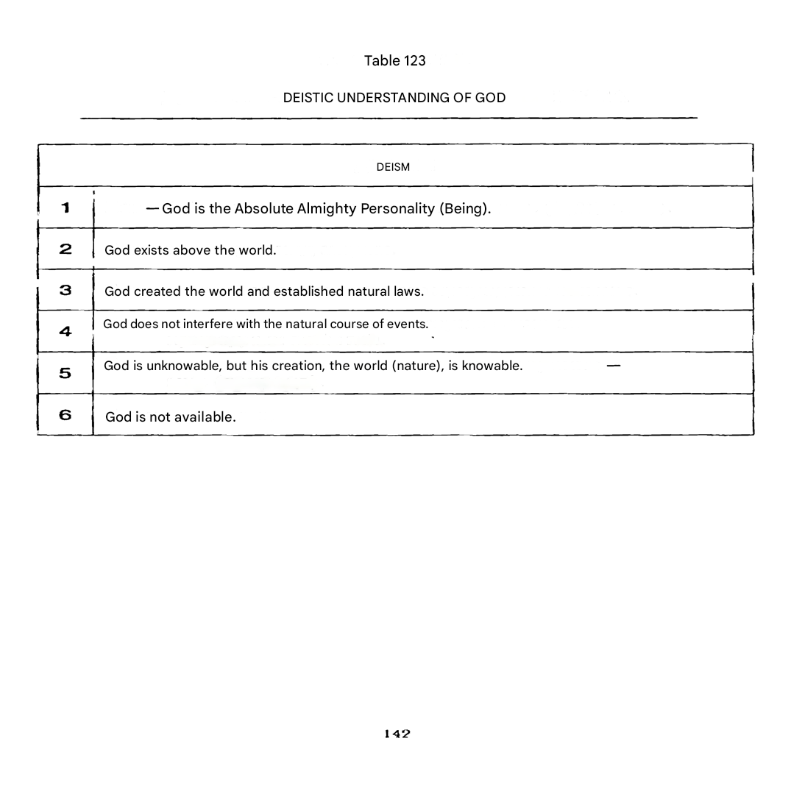

Slide 8
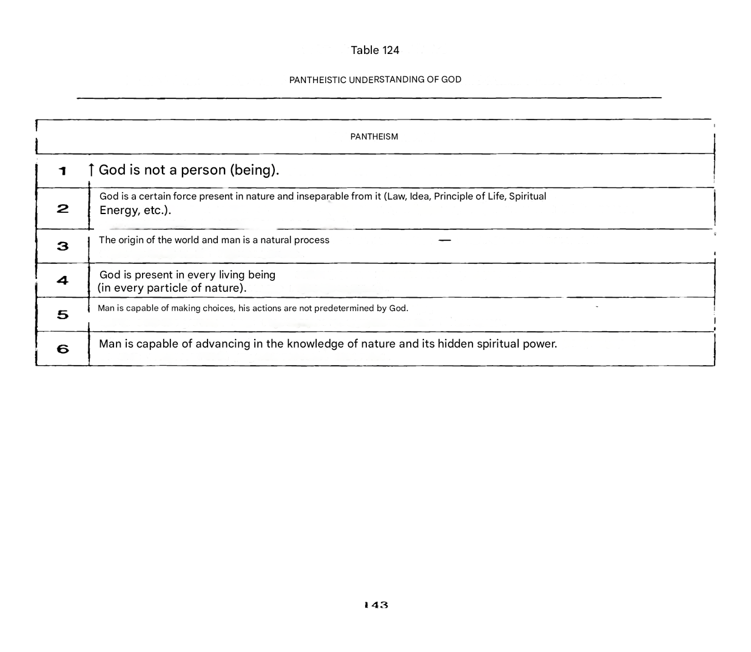

Slide 9
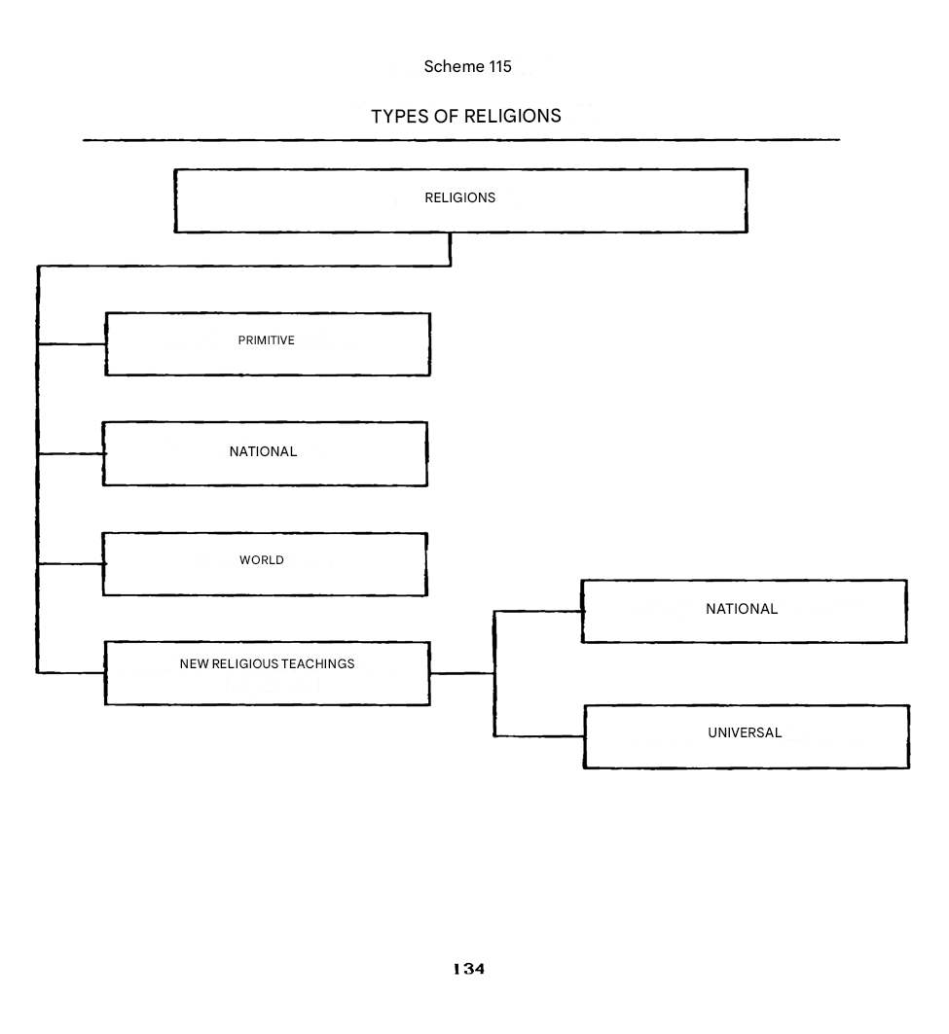

Slide 10
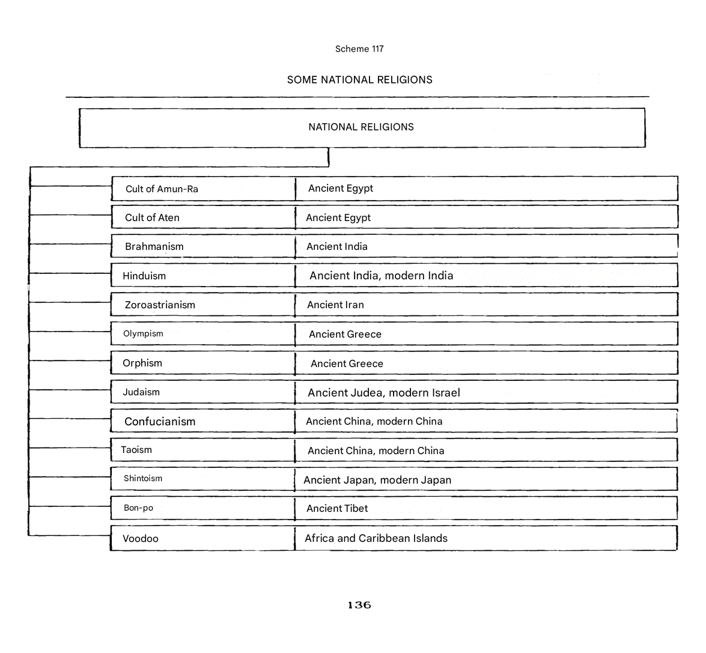

Slide 11
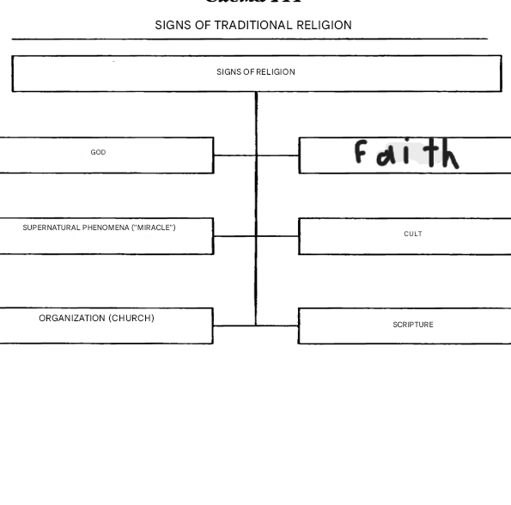

Slide 12
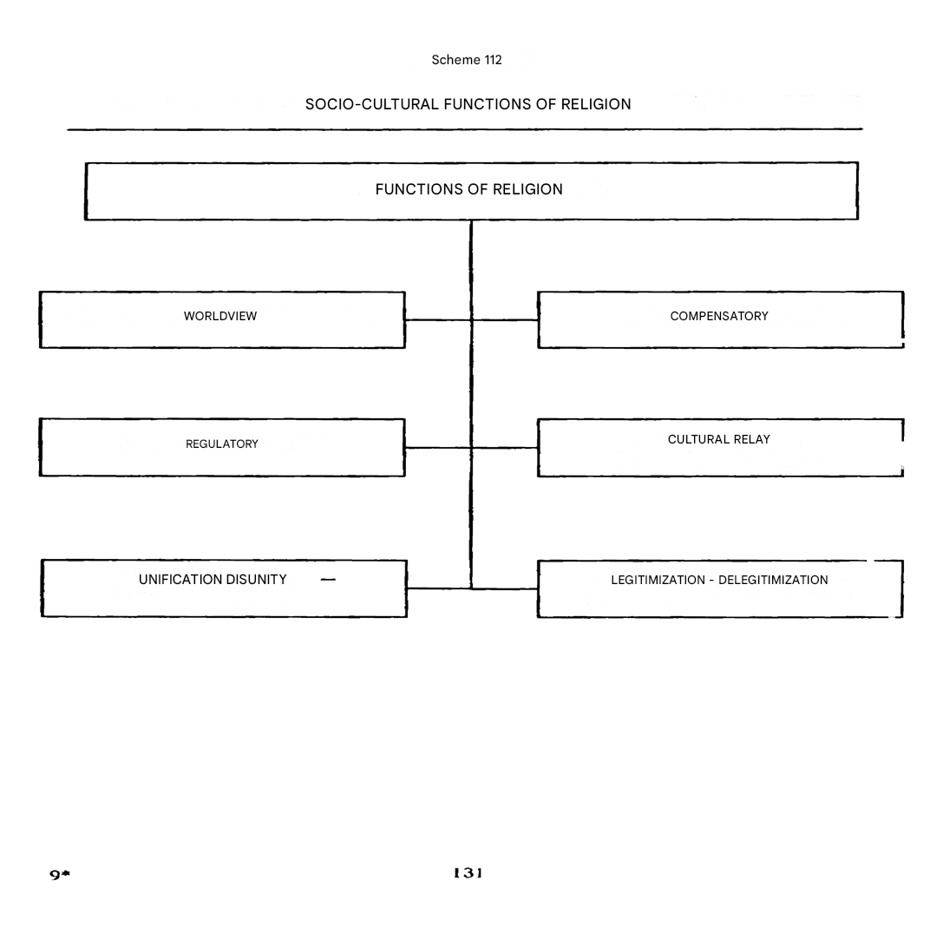

Slide 13
2. Origins and Early Forms of Religion

Slide 14
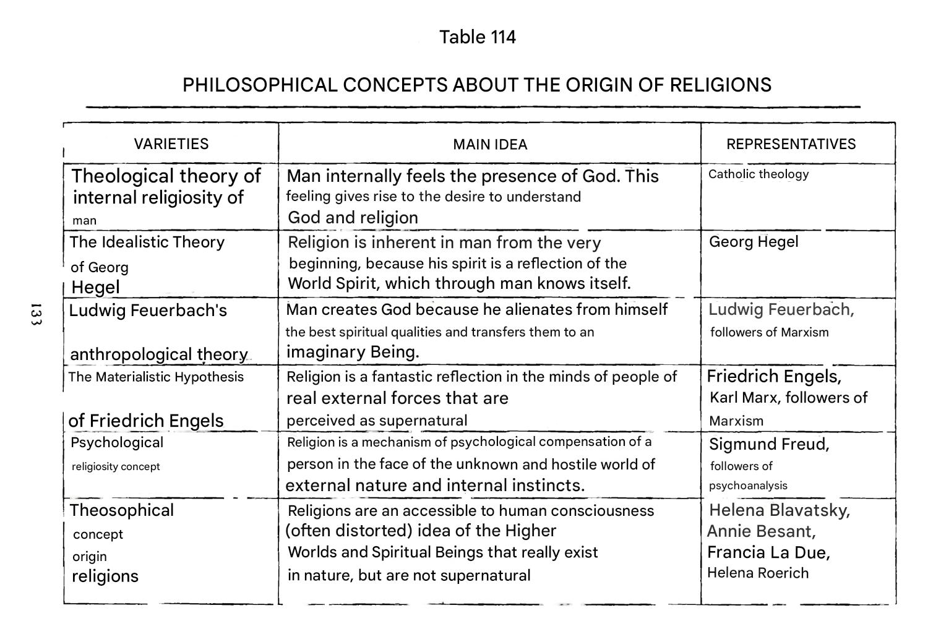

Slide 15
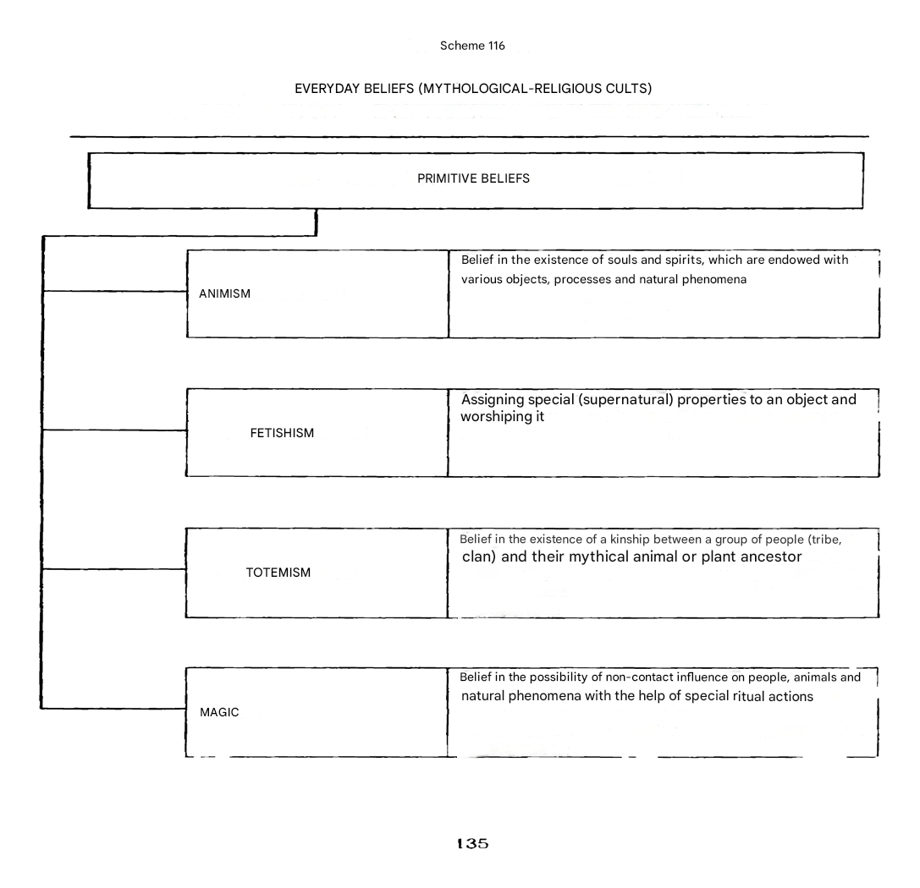

Slide 16
3. World religions:
Buddhism

Slide 17
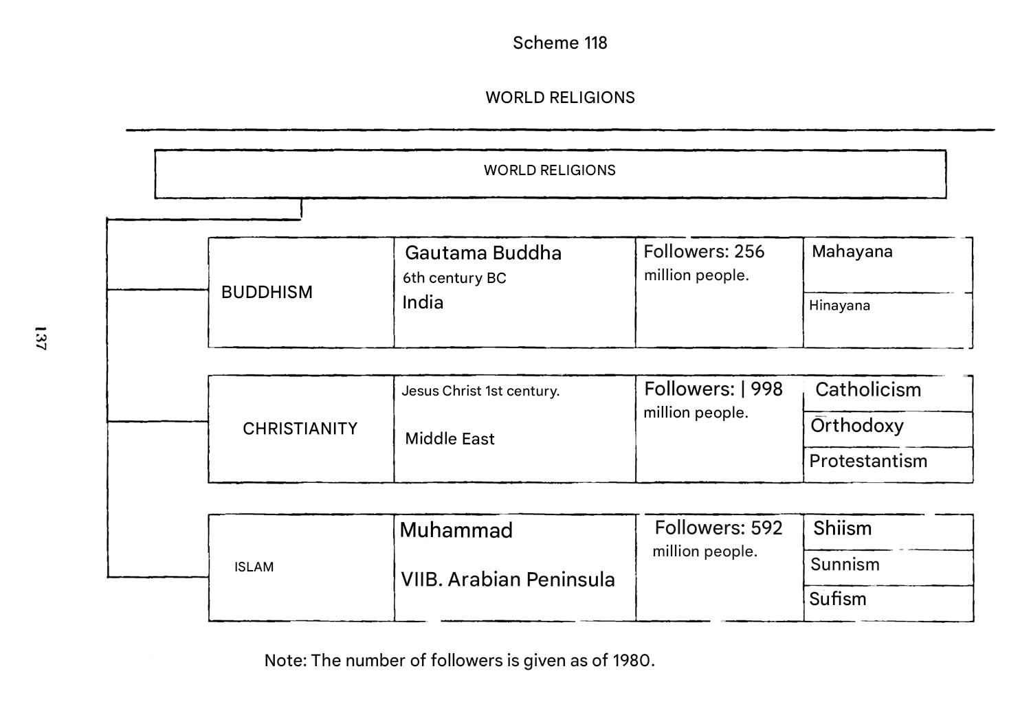

Slide 18
Buddhism arose in the middle of the of I millennium BC in the north of India as a trend in opposition to the Brahmanism prevailing at that time. In the mid. VI century BC, Indian society was experiencing a socio-economic and cultural crisis. Clan organization and traditional ties disintegrated, and class relations were formed. In these conditions, many wandering ascetics appeared, who offered their vision of the world. Their opposition to the existing order aroused people's sympathy. Among these teachings was Buddhism, which gained the greatest influence in society. According to researchers, the founder of Buddhism was a real person - the son of the head of the Shakya tribe (in the northeast of India), born in 560 BC - Siddhartha Gautama. Legend has it that the Indian prince Siddhartha Gautama, after a carefree and happy youth, acutely felt the frailty and hopelessness of life, the horror of the idea of an endless series of reincarnations. He left home in order to find an answer to the question: how can a person be freed from suffering? The prince traveled for seven years and one day, when he was sitting under the Bodhi tree, an illumination came to him. He found the answer to his question. The name Buddha means "enlightened one". Shocked by his discovery, he sat under this tree for several days, and then went down to the valley to join the people to whom he began to preach the new doctrine. He preached his first sermon in Benares. At first, he was joined by five of his former disciples, who left him when he renounced asceticism. Subsequently, he gained many followers. His ideas were close to many. The main truths revealed by the Buddha were as follows.

Slide 19
The whole life of a person is suffering. This truth is based on the recognition of the impermanence and transience of all things. Everything arises to be destroyed. Existence is devoid of substance, it devours itself, so in Buddhism it is designated as a flame. And only sorrow and suffering can be endured from the flame.
The cause of suffering is our desire. Suffering arises because a person is attached to life, he craves existence. Since existence is filled with sorrow, suffering will exist as long as a person longs for life.
To get rid of suffering, you need to get rid of desire. This is possible only as a result of achieving nirvana, which in Buddhism is understood as the extinction of passions, the cessation of thirst. Is this not at the same time the cessation of life? Buddhism avoids answering this question directly. Only negative judgments are expressed about nirvana: it is not desire or consciousness, neither life nor death. This is a state in which one is freed from the transmigration of souls. In later Buddhism, nirvana is understood as bliss consisting in freedom and spiritualization.
To get rid of desire, you need to follow the eightfold path of salvation. It is the determination of these stages on the path to nirvana that is the main one in the Buddha's teaching, which is called the middle way, which allows you to avoid two extremes: indulging sensual pleasures and torturing the flesh. This teaching is called the eightfold path of salvation because it indicates eight states by mastering which a person can achieve purification of mind, calmness and intuition.

Slide 20
These states are:
correct understanding: one should believe the Buddha that the world is full of sorrow and suffering;
right intentions: you should firmly determine your path, limit your passions and aspirations;
correct speech: one should watch one's words so that they do not lead to evil — the speech should be truthful and benevolent;
right actions: one should avoid non-virtuous actions, restrain oneself and do good deeds;
the right way of life: one should lead a decent life, without harming the living;
right efforts: you should watch the direction of your thoughts, drive away all evil and tune in to the good;
right thoughts: it should be understood that evil is from our flesh;
Right concentration: one should constantly and patiently train, achieve the ability to concentrate, contemplate, and go deeper in search of truth.

Slide 21
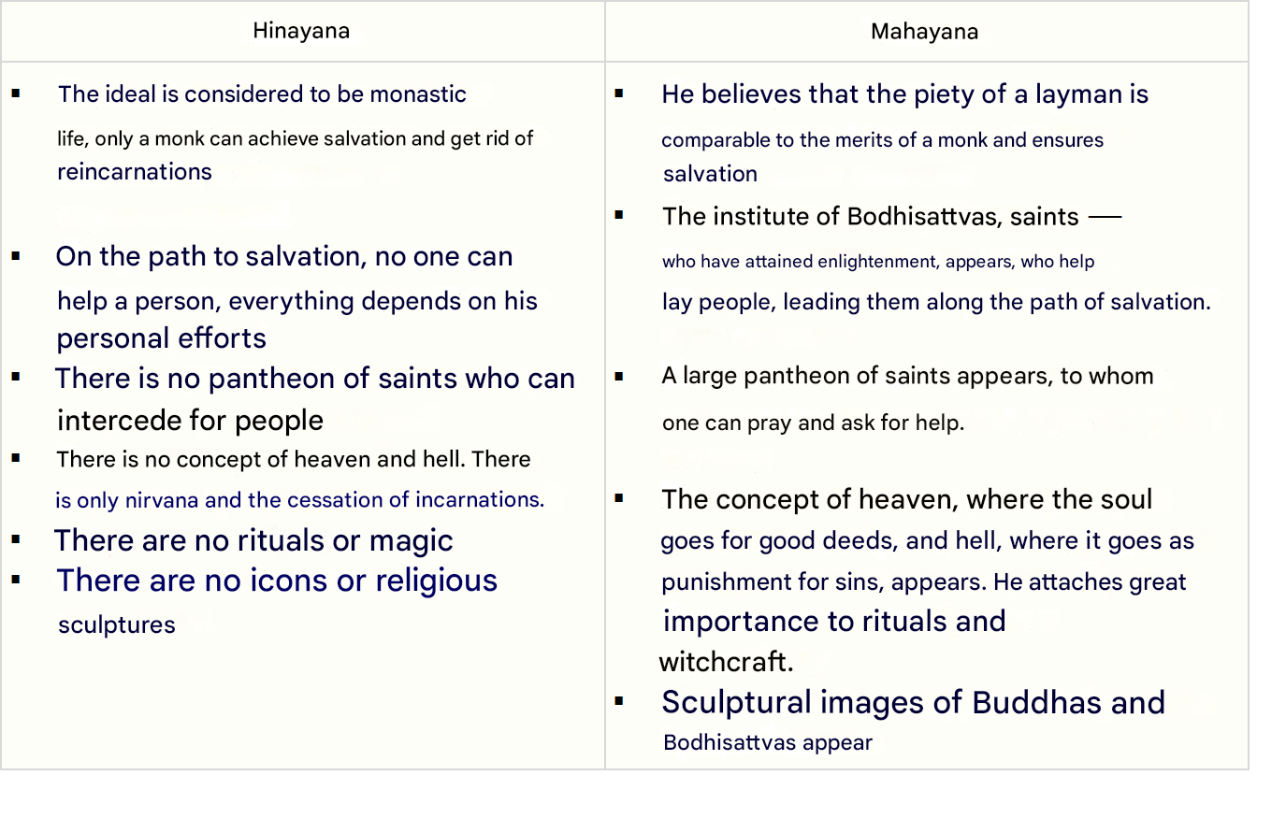
The features of the main trends in Buddhism are as follows (see table).

Slide 22
Buddha is considered the main god, but he is not the creator of the world, the world exists next to him, he is as eternal as Buddha. Gods are born and die at will. Above these six heavens are the 20 heavens of Brahma; The higher the celestial sphere, the easier and more spiritual life in it. In the last four, which are called brahmaloka, there are no more images and no rebirths, here the blessed ones are already eating nirvana. The rest of the world is called Kama-loka. Everything together forms the universe. There are an infinite number of such universes. An infinite number of universes is understood not only in a geographical, but also in a historical sense. Universes are born and die. The time of existence of the universe is called kalpa. Against this background of endless generation and destruction, the drama of life is played out.
However, the teaching of Buddhism avoids any metaphysical assertion, it does not speak of infinity, finiteness, eternity, non-eternity, being or non-being. Buddhism talks about forms, causes, images – all this is united by the concept of samsara, the cycle of incarnations. Samsara includes all things that arise and disappear, it is the result of past states and the cause of future actions arising according to the law of dhamma. The Dhamma is the moral law, the norm by which images are created; Samsara is the form in which the law is implemented. The Dhamma is not the physical principle of causality, but the moral world order, the principle of retribution. Dhamma and samsara are closely related, but they can only be understood in conjunction with the basic concept of Buddhism and the Indian worldview as a whole, the concept of karma. Karma means a concrete embodiment of the law, retribution or reward for specific deeds.

Slide 23
An important concept of Buddhism is the concept of "atman". It is usually translated as "individual soul". But Buddhism does not know the soul in the European sense. Atman means the totality of states of consciousness. There are many states of consciousness, which are called skandhas or dharmas, but it is impossible to find a carrier of these states that exists on its own. The totality of skandhas leads to a certain action, from which karma grows. Skandas disintegrate at death, while karma continues to live and leads to new existences. Karma does not die and leads to the transmigration of the soul. Man continues to exist not because of the immortality of the soul, but because of the indestructibility of his deeds. Karma, therefore, is understood as something material, from which everything that lives and moves arises. At the same time, karma is understood as something subjective, since it is created by the individuals themselves. So, samsara is the form, the embodiment of karma; The Dhamma is a law that is clarified by itself through karma. Conversely, karma is made up of samsara, which then affects subsequent samsara. This is the manifestation of dhamma. It is possible to free oneself from karma, to avoid further incarnations, only by achieving nirvana, about which Buddhism also does not say anything definite. It is not life, nor death, nor desire, nor consciousness. Nirvana can be understood as a state of desirelessness, as complete peace. From this understanding of the world and human existence, the four truths revealed by the Buddha follow.

Slide 24
4. World religions:
Christianity.

Slide 25
One of the world religions is Christianity. It arose in the 1st century AD in the eastern part of the Roman Empire - Palestine as a religion addressed to all the humiliated, thirsting for justice. It is based on the idea of messianism – the hope for the Divine Deliverer of the world from all the bad that exists on Earth. Jesus Christ suffered for the sins of people, whose name in Greek means "Messiah", "Savior". By this name, Jesus is associated with the Old Testament legends about the coming to the land of Israel of a prophet, a messiah who would free the people from suffering and establish a righteous life – the Kingdom of God. Christians believe that God's coming to Earth will be accompanied by the Last Judgment, when He will judge the living and the dead, direct them to heaven or hell.

Slide 26
Basic Christian ideas:
The belief that God is one, but He is the Trinity, i.e. God has three "persons": the Father, the Son and the Holy Spirit, which form the one God who created the universe.
Faith in the atoning sacrifice of Jesus Christ—the second person of the Trinity, God the Son—is Jesus Christ. He has two natures at the same time: Divine and human.
Faith in Divine grace is a mysterious power sent by God to free a person from sin.
Belief in posthumous retribution and afterlife.
Belief in the existence of good spirits – angels and evil spirits – demons together with their master Satan.

Slide 27
The holy book of Christians is the Bible, which means "book" in Greek. The Bible consists of two parts: the Old Testament and the New Testament. The Old Testament is the oldest part of the Bible. The New Testament (Christian works proper) includes: the four Gospels (Luke, Mark, John and Matthew); the Acts of the Holy Apostles; Epistles and Revelation of John the Theologian.
In the fourth century A.D., Emperor Constantine declared Christianity the state religion of the Roman Empire. Christianity is not one. It split into three currents. In 1054, Christianity was divided into the Roman Catholic and Orthodox churches. In the XVI century, the Reformation, an anti-Catholic movement, began in Europe. As a result, Protestantism appeared.

Slide 28
Orthodoxy and Catholicism recognize seven Christian sacraments: baptism, chrismation, repentance, communion, marriage, priesthood and anointing of the sick. The source of doctrine is the Bible. The differences are mainly as follows. In Orthodoxy there is no single head, there is no idea of purgatory as a place of temporary placement of the souls of the dead, the priesthood does not take a vow of celibacy, as in Catholicism. The Catholic Church is headed by the pope, elected for life, the center of the Roman Catholic Church is the Vatican, a state that occupies several quarters in Rome.
Protestantism has three main currents: Anglicanism, Calvinism and Lutheranism.
Protestants consider the condition for the salvation of a Christian not the formal observance of rites, but his sincere personal faith in the redemptive sacrifice of Jesus Christ. Their teaching proclaims the principle of universal priesthood, which means that every layperson can preach. Almost all Protestant denominations have reduced the number of sacraments to a minimum.

Slide 29
4. World religions:
Islam.

Slide 30
Islam is one of the world's religions. It arose in the VII century AD among the Arab tribes of the Arabian Peninsula. It is the youngest religion in the world. There are more than 1 billion followers of Islam. The founder of Islam, Muhammad, is a historical figure. He was born in 570 in the city of Mecca, which was a fairly large city at the intersection of trade routes for that time. In Mecca there was a shrine revered by the majority of pagan Arabs - the Kaaba. Muhammad's mother died when he was six years old, and his father died before his son was born. Muhammad was brought up in his grandfather's family, a noble but impoverished family. At the age of 25, he became the manager of the household of the rich widow Khadija and soon married her. At the age of 40, Muhammad acted as a religious preacher. He declared that God (Allah) had chosen him as his prophet. The ruling elite of Mecca did not like the preaching, and by 622 Muhammad had to move to the city of Yathrib, later renamed Medina. The year 622 is considered the beginning of the Muslim calendar according to the lunar calendar, and Mecca is the center of the Muslim religion.

Slide 31
The holy book of Muslims, the Koran, is a processed record of Muhammad's sermons. During Muhammad's lifetime, his statements were perceived as the direct speech of Allah and were transmitted orally. A few decades after Muhammad's death, they were written down and will make up the Quran.
In the doctrine of Muslims, an important role is played by the Sunnah, a collection of edifying stories about the life of Muhammad, and the Sharia, a set of principles and rules of behavior that are obligatory for Muslims. The most serious sins among Muslims are usury, drunkenness, gambling and adultery.

Slide 32
The religious building of Muslims is called a mosque. Islam prohibits depicting humans and animals, hollow mosques are decorated only with ornaments. In Islam, there is no clear division into clergy and laity. Any Muslim who knows the Koran, Muslim laws and rules of worship well can become a mullah (priest).
In Islam, great importance is attached to rituals. You may not know the subtleties of faith, but you should strictly follow the main rites, the so-called five pillars of Islam:

Slide 33
pronouncing the formula of confession of faith: "There is no God but Allah, and Muhammad is his prophet";
performing daily prayer five times a day (namaz);
fasting during the month of Ramadan;
giving alms to the poor;
making a pilgrimage to Mecca (Hajj).

Slide 34
Click on the table quickly twice and scroll down

